Slide 1
INTERNET OF THINGS (IOT)
K.S.V.SAMBASIVARAO
HOD
DEPT. OF ELECTRONICS
PBSC COLLEGE Of A& S
VIJAYAWADA

Slide 2
What is IOT??
The Internet of Things (IoT) is the connection of physical and visual objects.
It enables physical devices to collect and exchange data in an automated way. These devices are embedded with electronics, software, sensors, and network connectivity
It transfer data with out Human interference.

Slide 3
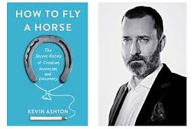
In the year 1999 Kevin Ashton the term internet of things and establishes MIT’s auto-id center , a global research network of academic laboratory focused on RFID and IOT.
He is father of IOT. He believed that IOT cloud can turn the world in to data that could be used to make macro decisions on resource utilization.
Information is a great way to reduce waste and increase efficiency.

Slide 4
Sensors and Actuators
Sensor:
It converts the physical quantity in to electrical signal.
It acts as Transducer
Ex: Temperature, pressure, Humidity, wind turbines.
Actuators:
It convert electrical signal in to physical form
Ex: fan, Ac, Electric motors.
For storing and processing of data on third party server known as cloud computing.
In audio related electronics like voice recognition and active noise cancellation are developed.
Embedded systems is a combination of hardware and software is not connected with internet.

Slide 5
BLOCK DIAGRAM FOR IOT
Collect: Devices and sensors are collecting data everywhere
Ex: Athome, car, office
Communicate: sending data and event through networks to some destination
Ex: A cloud Platform, Home network, Private data center
Analyze: Creating information from the data.
Ex:visualizing the data, building reports, filtering data.
ACT: taking action based on the information and data
Ex: communicate with another machine (m2m),send a notification (SMS, e-mail, text),talk to another system.
collect
communicate
analyze
act

Slide 6
HOW IOT WORKS
RFID : To identify and track the data of Things
Sensor : To collect and process the data to detect the changes in the physical status of things
Smart tech: To enhance the power of the networking by developing processing capabilities to different part of the network.
Nanotech : to make the smaller and smaller things have the ability connect and interact
RFID
SENSOR
SMART TECH
NANO
TECH

Slide 7
CONSUMER GOODS
IOT playing a vital role on human goods are effected.
Mobile:click—12 years
Youtube: click—4 years
Facebook:click—3years
Twitter:click—2years
Gaming:click—hours
Previously IOT past is analog form now it is in digital.

Slide 8
APPLICATIONS OF IOT
Building and home automation
Manufacturing
Medical and health care systems
Media
Environmental monitoring
Energy management
Transportation
In basic approach for IOT is capture, communicate, analyze, act.

Slide 9
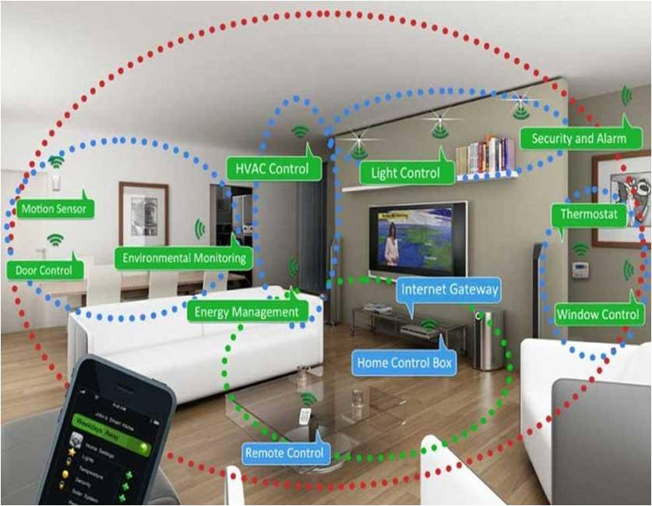
Smart Homes
If switch on air conditioning before reaching home or switch off lights even after you have left home? Or unlock the doors to friends for temporary access even when you are not at home. Don’t be surprised with IoT taking shape companies are building products to make your life simpler and convenient and it is also used to keep our home from security breach

Slide 10
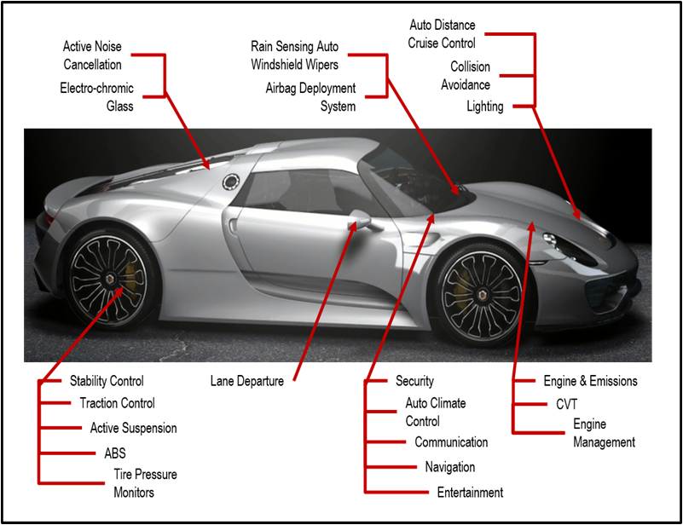
Connected Cars
A connected car is a vehicle which is able to optimize it’s own operation, maintenance as well as comfort of passengers using onboard sensors and internet connectivity.

Slide 11
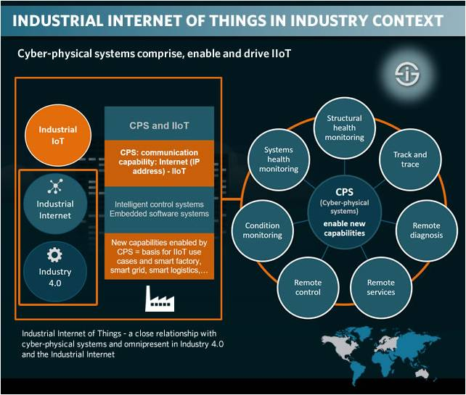
Industrial Internet
Industrial Internet is the new buzz in the industrial sector, also termed as Industrial Internet of Things (I IOT).
It is empowering industrial engineering with sensors. Software
A big data analytics
To create brilliant machines.

Slide 12
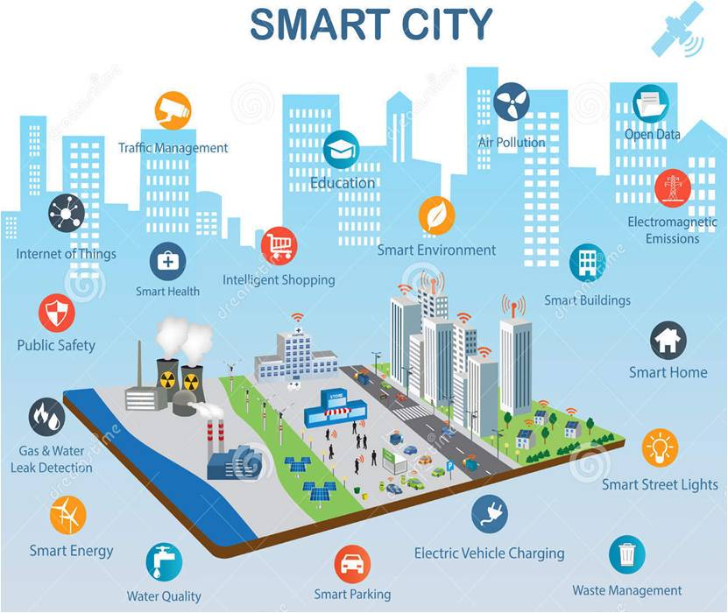
Smart Cities
Smart city is another powerful application of IoT generating curiosity among world’s population.
Smart surveillance
Automated transportation,
Smarter energy management systems
Water distribution
Urban security and environmental monitoring all are examples of internet of things.

Slide 13
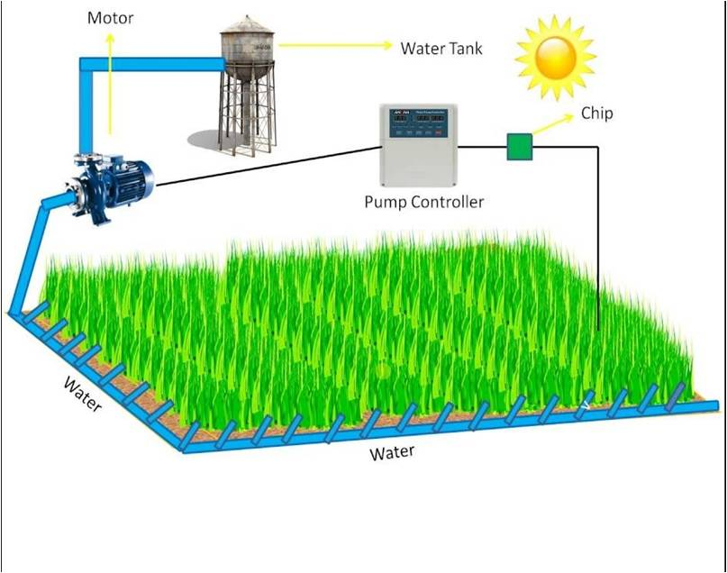
Agriculture
Smart farming is a concept quickly catching on in the agricultural business.
IOT sensors capable of providing farmers with information about :
Crop yields
Rainfall
Pest infestation
Soil nutrition
Data which can be used to improve farming techniques over time.

Slide 14
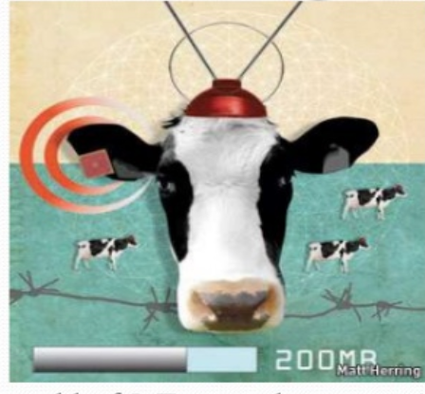
SENSORS
In the world of IOT even the cows will be connected and monitored sensors are implanted in the ears of cattle this allows the farmers to monitor cows health and track their moments ensuring a healthier more plentiful supply of milk on average each cow generates about 200MB of information per year.

Slide 15
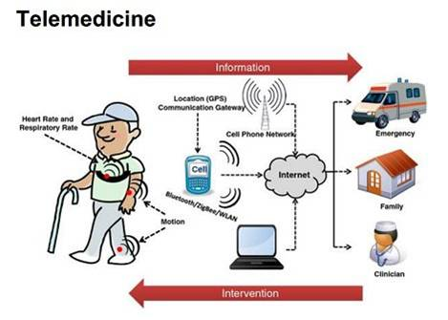
Healthcare
Connected healthcare yet remains the sleeping giant of the IOT applications.
The concept of connected healthcare system and smart medical devices bears enormous potential not just for companies, but also for the well-being of people in general.

Slide 16
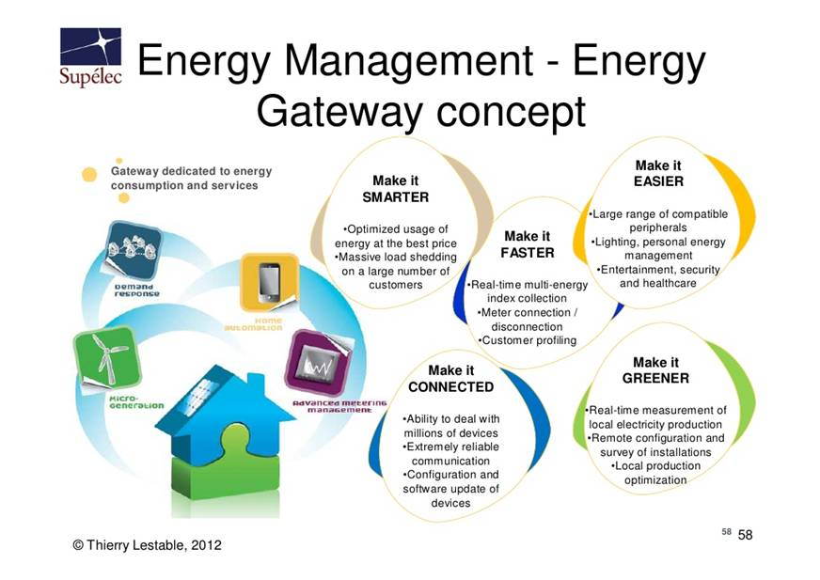
Energy Engagement
Power grids of the future will not only be smart enough but also highly reliable.
Smart grid concept is becoming very popular all over world.
smart grids is to collect data in an automated fashion and analyze the behavior or electricity consumers and suppliers for improving efficiency as well as economics of electricity use.

Slide 17
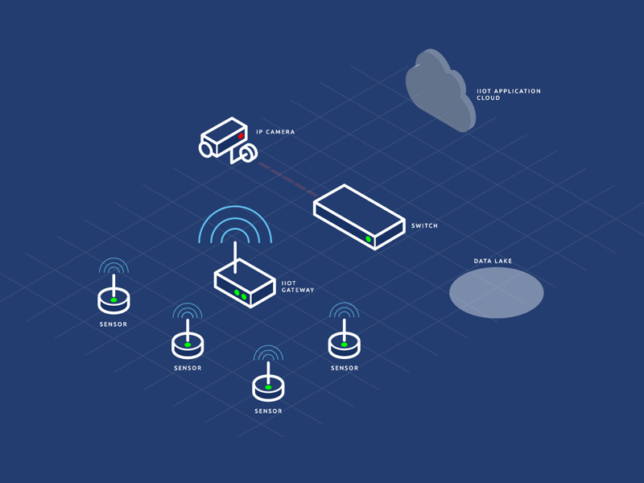

Slide 18
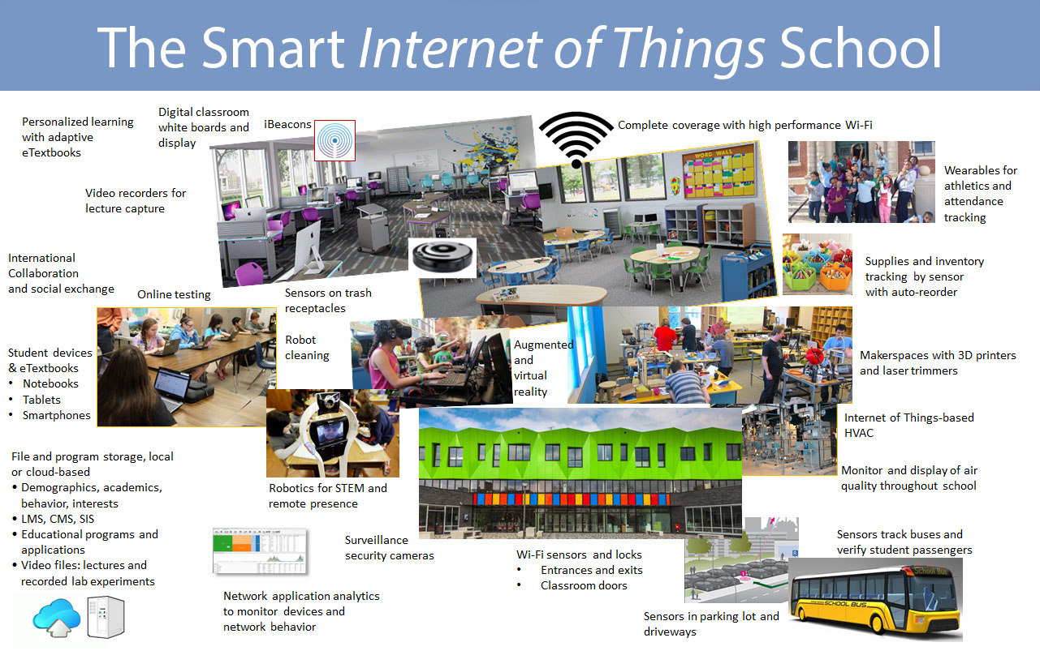

Slide 19
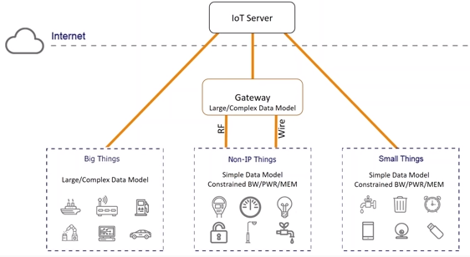
Internet of Things Gateway

Slide 20
NODE MCU
It is a open source IOT platform refers to lua based software developed for ESP8266 Wi-Fi module
It version is 0.9 (version-1) and hardware and their hardware design is open for edit/modify /build
ESP8266 is low cost Wi-Fi developed by Espressif systems with TCP/IP protocol.
It’s kit has Arduino like analog (A0) and digital (Do-D8)pins on board.
It support serial communication protocols i.e. UART,SPI,I2C etc by using this we can connect more devices like GPS modules, Touch Screen, SD cards—
It supports two codes:
1.Node MCU with Esplorer IDE. (c-language)
2.Node MCU with Arduino IDE.

Slide 21
BLYNK APP
It is an account provide you with a reliable and secure access to your hardware from anywhere in the world no matter which device or OS you use.
It is free open source and you can install in 1 minute.
It forward message between blynk mobile application and various microcontroller boards (i.e Arduino, Raspberry pi.)
Blynk server is responsible for all communications between smart phone and hardware.

Slide 22
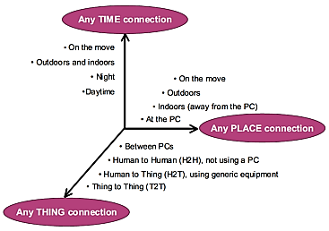
Connectivity for Anything

Slide 23
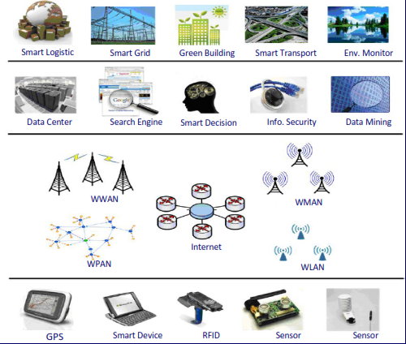
4LayersModelofIoT
Integrated
Application
Information
Processing
Network
Construction
Sensing and
Identification

Slide 24
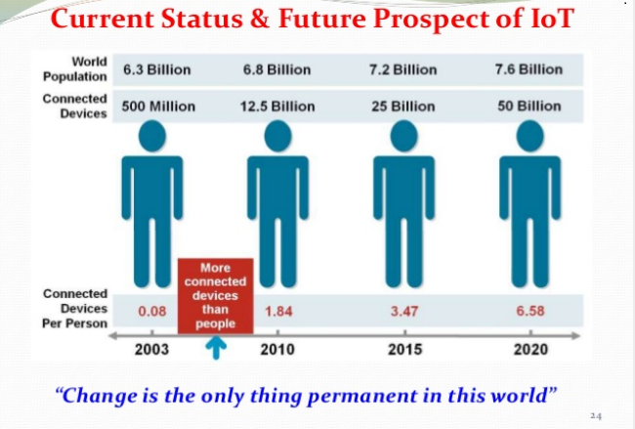
Growth of IOT

Slide 25
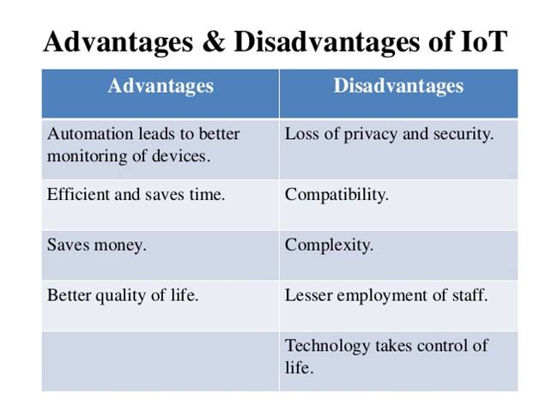

Slide 26
Attacking IoT
Default, weak, and hardcoded credentials
Difficult to update firmware and OS
Lack of vendor support for repairing vulnerabilities
Vulnerable web interfaces (SQL injection, XSS)
Coding errors (buffer overflow)
Clear text protocols and unnecessary open ports
DoS / DDoS
Physical theft and tampering

Slide 27
Applications of IoT
-Connected Cars
-Smart Home
- Industrial Internet
-Smart Cities
-Agriculture
-Healthcare
-Energy Engagement
-In basic approach for IOT is capture, communicate, analyze and act.

Slide 28
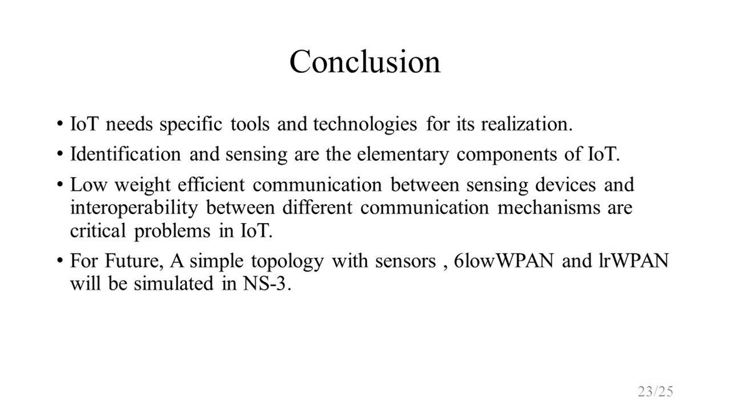
Conclusion

